Slide 1
Ventilation
Dr. D T D Warnakulasuriya
Department of Physiology
Faculty of Medicine
University of Kelaniya

Slide 2
Ventilation
The process of airflow between atmosphere and alveoli
Air flow results from pressure gradients created by changing the volume of the lungs

Slide 3
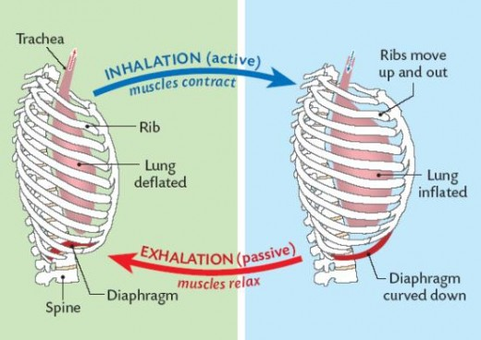
Breathing
Inspiration and expiration in a cyclic manner
Inspiration- Active process
During quiet breathing
Diaphragm
Increase height of thoracic cage
75% of volume change
External intercostal muscles
Elevate lower ribs, push sternum outwards
Increase AP diameter (and transverse diameter)
25% of volume change
Notes:
External intercostal muscles Increase AP diameter >> transverse diameter
Diapghragm or the EIM can maintain adequate ventilation at rest.

Slide 4
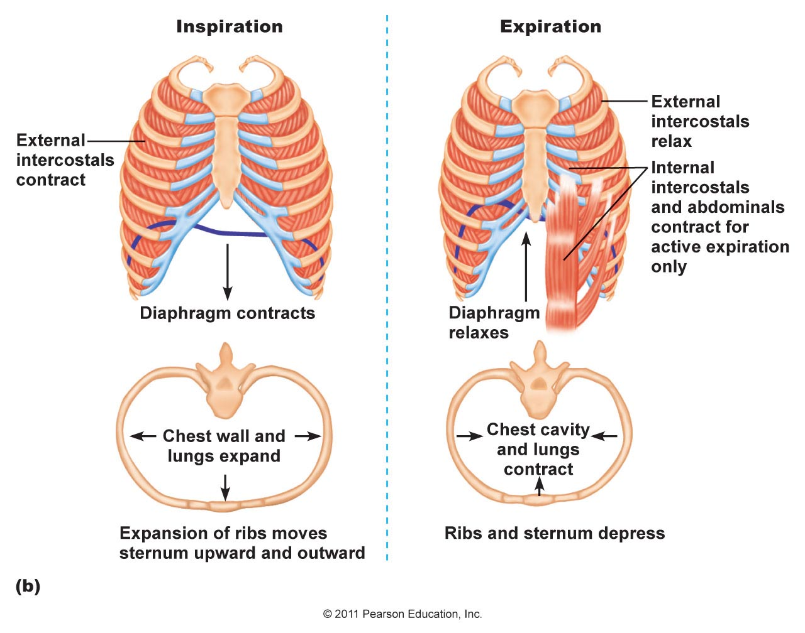
Breathing
Expiration – Passive process
Elastic recoil of lung and chest wall

Slide 5
In deep inspiration
Accessory muscles of inspiration contract
e.g. sternocleidomastoids, Scalene, anterior serrati
Forced expiration is due mainly to ↑ intra-abdominal pressure.
Expiratory muscles
internal intercostals- pull rib cage down,
rectus , transversus abdominis,external & internal obliques-
push abdominal content up,

Slide 6
The relationship between pressure and volume is expressed by Boyle's law
Boyle’s law
The pressure of gas in any container is inversely related to
the volume of the container
P α 1/ V
when volume ↑ , pressure ↓
when volume ↓ , pressure ↑

Slide 7
The different pressures involved in breathing
Atmospheric pressure
Intra-alveolar pressure
Intra-pleural pressure
Transmural pressures

Slide 8
Intra-alveolar pressure P_{alv}
The pressure inside the alveoli
During inspiration P_{alv} < P_{atm}
During expiration P_{alv} > P_{atm}
At rest P_{alv} = P_{atm}
When it is equal to atmospheric pressure it is considered to be 0

Slide 9
Intra-pleural pressure P_{pl}
In quiet inspiration, P_{pl} changes from -2.5 to -6 mmHg
In deep inspiration, P_{pl} reduces as much as -30mmHg
P_{pl} = intra esophageal pressure
is always negative (that is, less than atmospheric pressure) during normal breathing
Kept negative by elastic forces of chest wall and lungs

Slide 10
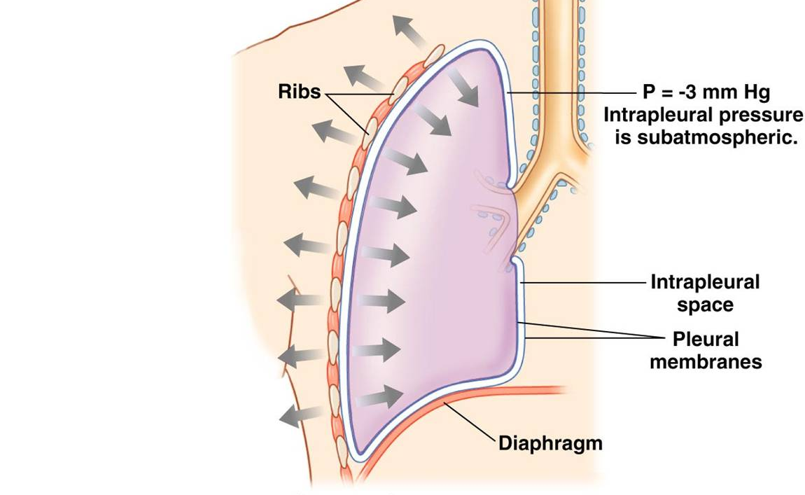
AT REST
P_{pl}=-2.5 mmHg

Slide 11
Transmural Pressures
Trans-chest wall pressure/ transmural pressure across the chest wall
P_{atm} — P_{pl}
Transpulmonary (trans-lung) pressure
P_{alv} — P_{pl}
Causes the lungs to expand
Trans-respiratory system pressure between the intra-alveolar pressure and the atmosphere
P_{atm} — P_{alv}

Slide 12
P_{atm}
P_{pl}
Trans-chest wall pressure
P_{alv}
Trans-pulmonary pressure
LUNG WALL
Trans-respiratory system pressure
CHEST WALL

Slide 13
Ventilation
During breathing, air flows between atmosphere and alveoli
Flow along the conducting system is by bulk flow and due to pressure gradients between the atmosphere and alveoli
Flow in the ventilatory units is by diffusion of individual gases along partial pressure gradients

Slide 14
BULK FLOW
Flow of air into and out of the lungs occurs along pressure gradients created between the external environment and the alveoli
F_{flow} = k ( P_{atm} - P_{alv} )/ R_{aw}
The rate of flow is equal to the pressure gradient over the resistance encountered by air as it flows through the air passageways

Slide 15
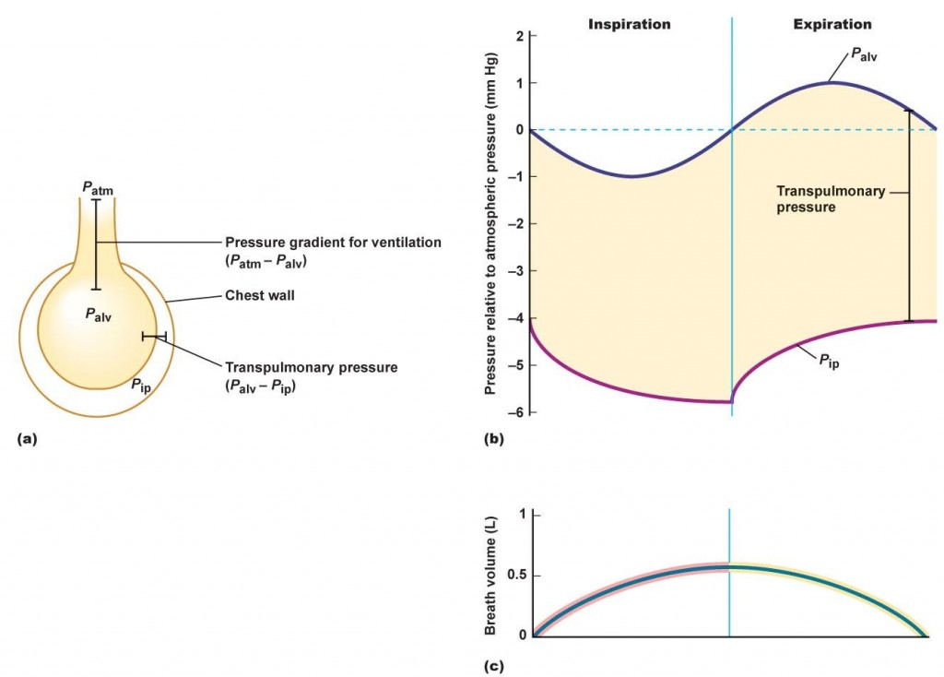
Expansion of the thoracic cavity
↓ intrapleural pressure (P_{pl})
↑ transpulmonary pressure (P_{alv} - P_{pl})
Lungs expand
↑volume of the alveoli
↓intra-alveolar pressure (P_{alv})
The pressure gradient (P_{atm} - P_{alv}) causes air to flow in
Air flow continues until P_{alv =} P_{atm}

Slide 16
Expiration is a passive process :
inspiratory muscles relax
elastic recoil of the chest wall and lungs
↓ volume of the alveoli
↑intra-alveolar pressure
The pressure gradient (P_{atm} - P_{alv}) causes air to flow out

Slide 17
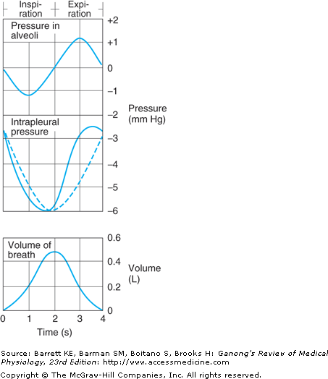
Changes in Intra-pleural pressure during breathing

Slide 18
Changes in Intra-alveolar pressure during breathing

Slide 20
DIFFUSION
Oxygen diffuses along a partial pressure gradient from the alveolar air spaces in to the pulmonary capillaries through the alveolar-capillary membrane
Carbon-dioxide diffuses in the opposite direction
Airflow depends on factors affecting diffusion

Slide 21
Breathing can be,
Negative pressure breathing
P_{atm} is held constant while P_{alv} is lowered allowing air to come in
Normal breathing or use of negative pressure ventilators
Positive pressure breathing
P_{atm} is increased > atmospheric pressure while P_{alv} is held constant
mouth to mouth breathing or use of positive pressure ventilators

Slide 22
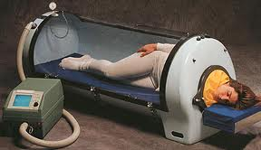
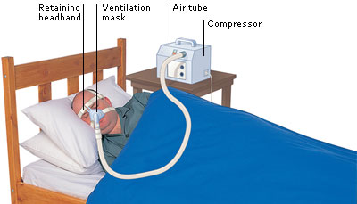
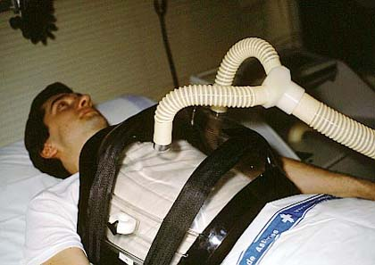
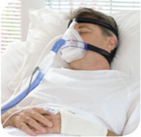
Negative pressure ventilation
Positive pressure ventilation

Slide 23
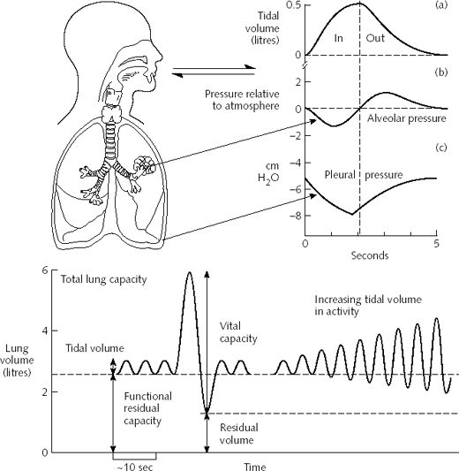
In summary

Slide 24
Objectives:
At the end of this lecture, the student should be able to understand the
process of breathing (ventilation)
role of Boyle’s Law in ventilation
changes in pressures involved in ventilation
Atmospheric pressure
Intra-alveolar pressure
Intra-pleural pressure
Transmural pressure
Difference between positive pressure and negative pressure breathing

